Slide 1
ALGEBRA 4
Day 48

Slide 2

Bell Work
In quadrilateral PQRS below,
sides PS and QR are parallel for what value of x ?
Individual Question
182
132
112
110
70

Slide 3
5.4 Dividing Polynomials
Objectives:
To Divide Polynomials Using Synthetic Division.
To know that Long Division exists.

Slide 4
To Divide Polynomials:
Write polynomial in standard form
Put 0’s in for missing parts
You have to remember 0’s as place holders!!!!

Slide 5
Long Division
Allows you to divide any polynomial by another polynomial
The process is long, thus the name, and we have better options
If you want to see it… I can show you another time! ☺

Slide 6
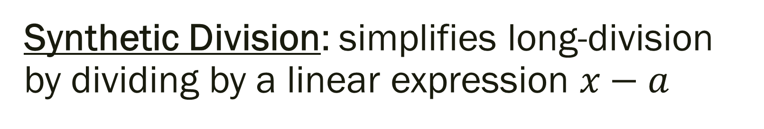
Synthetic Division: simplifies long-division by dividing by a linear expression $x−a$
Steps to using Polynomial Synthetic Division:
Write the equation in standard form
(put 0’s in for exponents not represented)
Multiply leading coefficient by the value of the variable
Sum the next coefficient with the answer from Step 2
Multiply the answer from Step 3 by the value of the variable
Sum the next coefficient with the answer from Step 4
Continue until each coefficient has been used

Slide 7
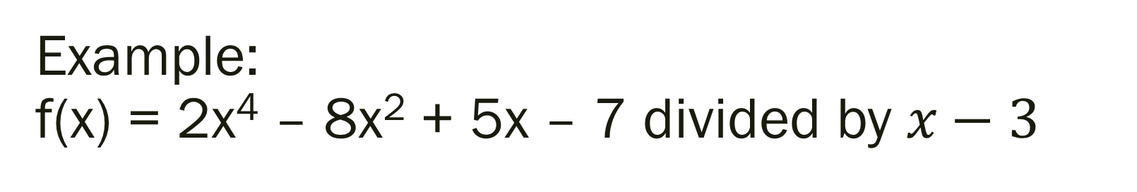
Example: f(x) = 2x⁴ – 8x² + 5x – 7 divided by $x−3$

Slide 8
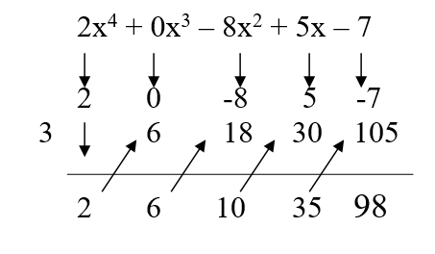

Example: f(x) = 2x⁴ – 8x² + 5x – 7 divided by $x−3$
2x⁴ – 8x² + 5x – 7 = (2x³ +6x² + 10x +35)(x-3) + R: 98

Slide 9
Remainder Theorem; If a polynomial f(x) is divided by x – k, then the remainder is r = f(k)
Based on the last problem…
By the Remainder Theorem, f(3) is the remainder when you divide f(x) by x – 3
f(3) = 98

Slide 10
Is (x+5) a factor of x³ +7x² -38x – 240? If yes, what are the other factors? If no, what is the remainder?

Slide 11
Is (x+5) a factor of x³ +7x² -38x – 240? If yes, what are the other factors? If no, what is the remainder?
Since you get a remainder of 0 when doing synthetic division, then (x+5) is a factor
The other factors are (x+8) and (x–6)
Therefore, x³ +7x² -38x – 240 = (x+5)(x+8)(x–6)

Slide 12
Thinking Ahead… Solve
x³ – 2x² - x – 6 = 0

Slide 13
For Next Time
Page 308 #1-7, 11-25 (odd), 29, 33-37 (odd), 41
(Extra Practice #44-62)

Slide 14
5.5 Theorems About Roots of Polynomial Equations
Objectives: To Solve Equations using the Rational Root Theorems
To use the Conjugate Root Theorem

Slide 15
We are going to skip this because of time with the snow days…
The idea… is that we could solve these without a calculator by looking at the constant and the lead coefficients factors…
We okay using our calculator to graph and find the zeros???

Slide 16
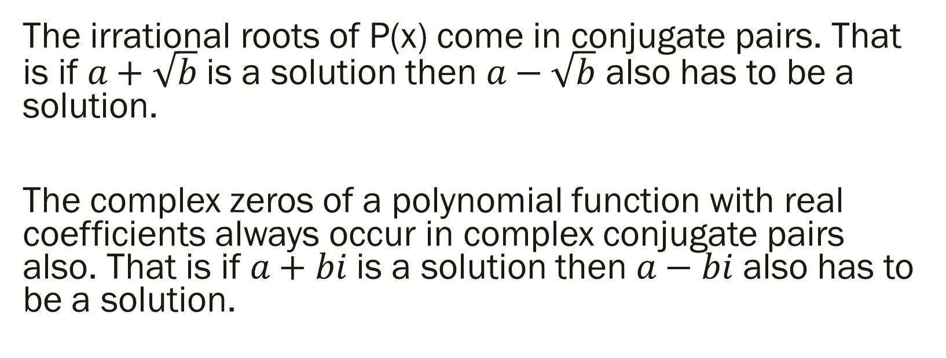
Conjugate Root Theorem:
The irrational roots of P(x) come in conjugate pairs. That is if $a+\sqrt{b}$ is a solution then $a−\sqrt{b}$ also has to be a solution.
The complex zeros of a polynomial function with real coefficients always occur in complex conjugate pairs also. That is if $a+bi$ is a solution then $a−bi$ also has to be a solution.

Slide 17

Example: What are the other roots?
Given
1.) 4, 4, 2 + i 2.) 0, 7, -6i 3.) $5, 7+\sqrt{2}$

Slide 18
Example: What are the other roots?
Given
1.) 4, 4, 2 + i 2.) 0, 7, -6i 3.) $5, 7+\sqrt{2}$
$$2−i 6i 7−\sqrt{2}$$

Slide 19
For Next Time
pg 315 #1-6, 8, 11-25 (odd), 39
(optional assignment)

